Slide 1


Lecture 18
Produced by Dr. Worldwide
Welcome to the 305
~
~

Slide 2


Ex: Oregon Atlantic Company
Oregon Atlantic Company produces two paper products
Newsprint
Wrapping paper
Labor
Need 5 minutes per yard of newsprint
Need 8 minutes per yard of wrapping paper
Company has 4,800 minutes per week
Profit
Make $0.20 for a yard of newsprint
Make $0.25 for a yard of wrapping paper
Demand
500 yards of newsprint per week
400 yards of wrapping paper per week

Slide 3
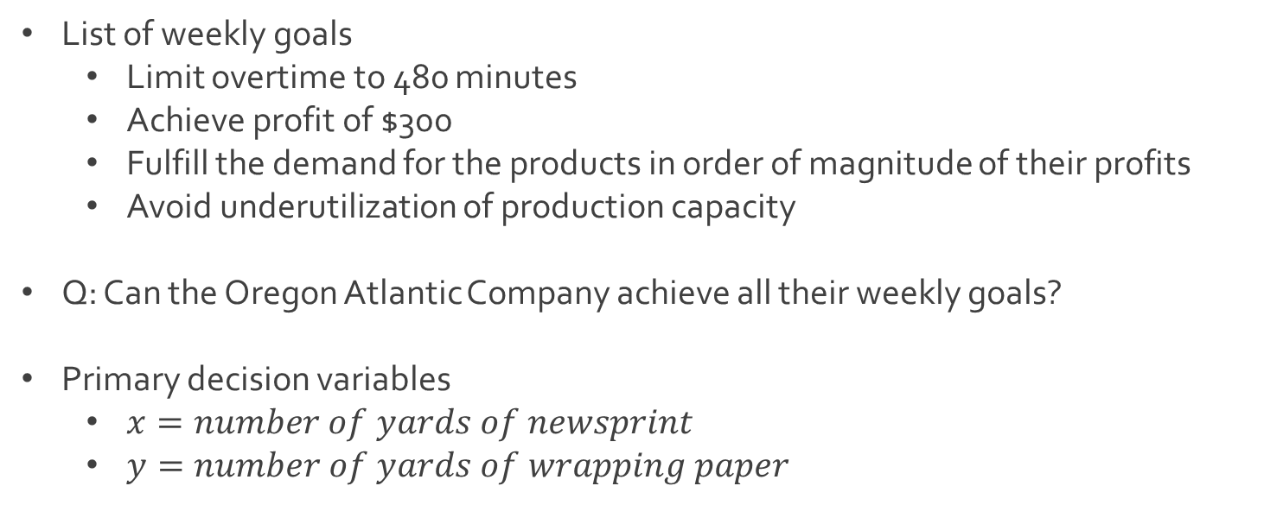
Ex: Oregon Atlantic Company
List of weekly goals
Limit overtime to 480 minutes
Achieve profit of $300
Fulfill the demand for the products in order of magnitude of their profits
Avoid underutilization of production capacity
Q: Can the Oregon Atlantic Company achieve all their weekly goals?
Primary decision variables
$x=number of yards of newsprint$
$y=number of yards of wrapping paper$

Slide 4


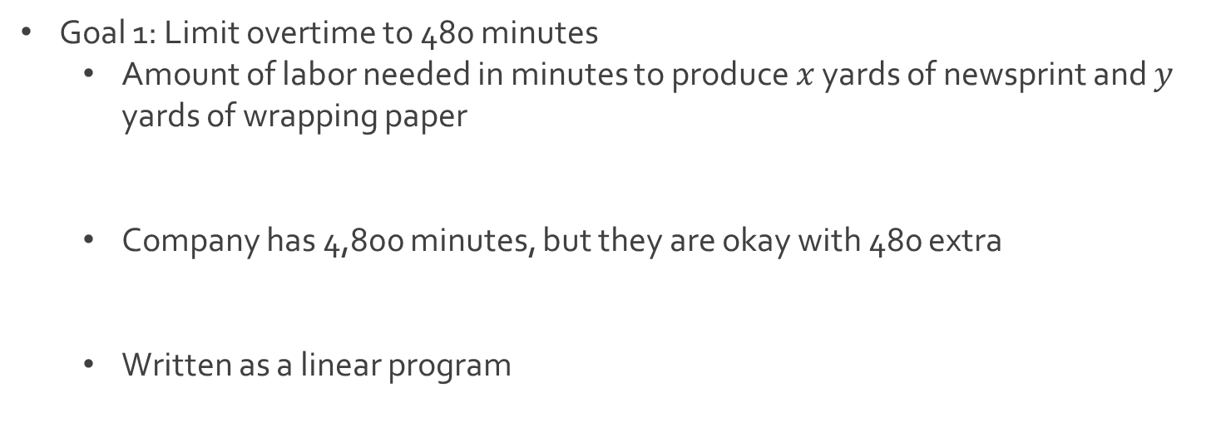
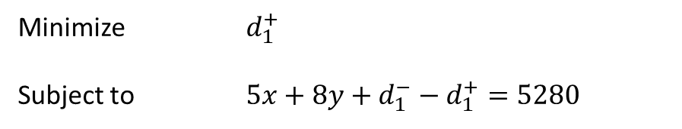
Ex: Oregon Atlantic Company
Goal 1: Limit overtime to 480 minutes
Amount of labor needed in minutes to produce $x$ yards of newsprint and $y$ yards of wrapping paper
Company has 4,800 minutes, but they are okay with 480 extra
Written as a linear program
$$5x+8y$$
$$5x+8y≤4800+480=5280$$
Minimize $d_{1}^{+}$
Subject to $5x+8y+d_{1}^{−}−d_{1}^{+}=5280$

Slide 5


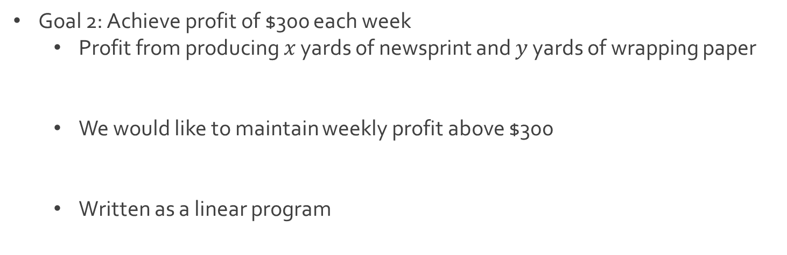
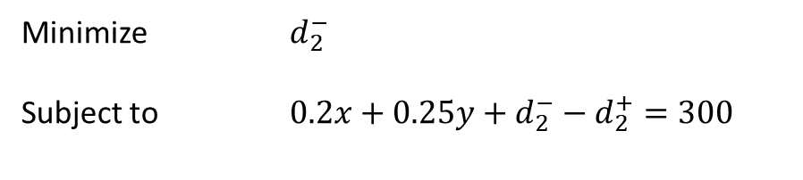
Ex: Oregon Atlantic Company
Goal 2: Achieve profit of $300 each week
Profit from producing $x$ yards of newsprint and $y$ yards of wrapping paper
We would like to maintain weekly profit above $300
Written as a linear program
$$0.2x+0.25y$$
$$0.2x+0.25y≥300$$
Minimize $d_{2}^{−}$
Subject to $0.2x+0.25y+d_{2}^{−}−d_{2}^{+}=300$

Slide 6
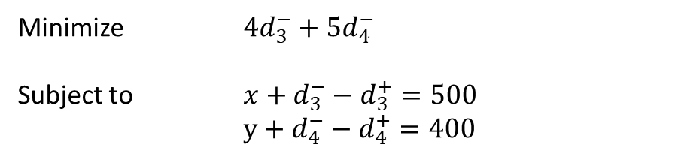

Ex: Oregon Atlantic Company
Goal 3: Fulfill the demand for newsprint and wrapping paper
Based on weekly demands, we want
We want to prioritize fulfilling demands according to their profit
Written as a linear program
$$x≥500$$
$$y≥400$$
$$\frac{Profit of newsprint}{Profit of wrapping paper}=\frac{0.2}{0.25}=\frac{20}{25}=\frac{4}{5}$$
Minimize ${4d}_{3}^{−}+5d_{4}^{−}$
Subject to $x+d_{3}^{−}−d_{3}^{+}=500$
$y+d_{4}^{−}−d_{4}^{+}=400$

Slide 7
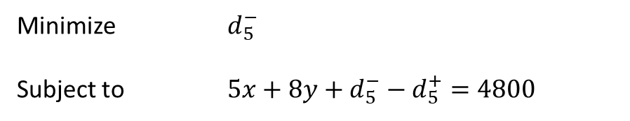

Ex: Oregon Atlantic Company
Goal 4: Avoid the underutilization of production capacity
Remember that company has 4,800 minutes of normal production
We would like to use all this production
Written as a linear program
Class activity
Split up class into 4 groups
Give each group different ordering of goals according to priority
Each group solves goal programming model
Compare and discuss the results from the 4 groups
$$5x+8y≥4800$$
Minimize $d_{5}^{−}$
Subject to $5x+8y+d_{5}^{−}−d_{5}^{+}=4800$

Slide 8
Ex: Oregon Atlantic Company
Division of class
Center Stage
Group IV
Download Sheet 4
Group I
Download Sheet 1
Group III
Download Sheet 3
Group II
Download Sheet 2

Slide 9


Ex: Oregon Atlantic Company
Same set of constraints for all groups
Recall the objectives for minimization
$d_{1}^{+}$ (Limit Overtime)
$d_{2}^{−}$ (Achieve Profit)
${4d}_{3}^{−}+5d_{4}^{−}$ (Fulfill Demand)
$d_{5}^{−}$ (Avoid Underutilization of Labor)
$$5x+8y+d_{1}^{−}−d_{1}^{+}=5280$$
$$0.2x+0.25y+d_{2}^{−}−d_{2}^{+}=300$$
$$x+d_{3}^{−}−d_{3}^{+}=500$$
$$y+d_{4}^{−}−d_{4}^{+}=400$$
$$5x+8y+d_{5}^{−}−d_{5}^{+}=4800$$
$$x,y,d_{i}^{−},d_{i}^{+}≥0$$

Slide 10
Ex: Oregon Atlantic Company
Different groups are different branches of the same company
Group 1 doesn’t prioritize labor and cares most about minimizing cost and increasing the desired profit
Group 2 cares most about profit and fulfilling demand and least about the utilization of labor
Group 3 cares most about fulfilling the demands of their customers and least about reaching the desired profit
Group 4 cares most about making sure their employees reach the desired regular production capacity and the ideal overtime scenario

Slide 11
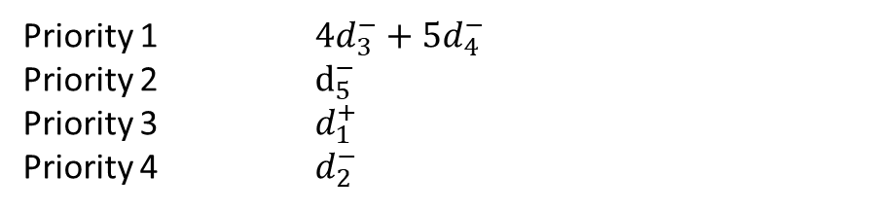
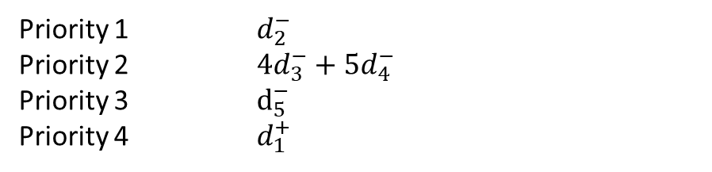
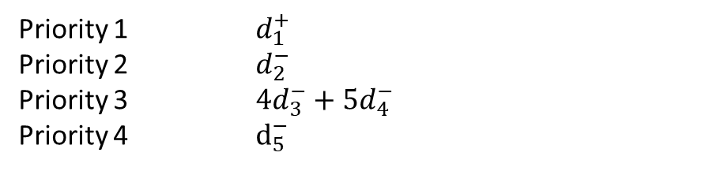
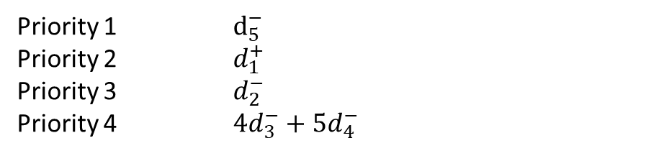
Ex: Oregon Atlantic Company
Division of priorities
Center Stage
Group IV
Group I
Priority 1 $d_{5}^{−}$
Priority 2 $d_{1}^{+}$
Priority 3 $d_{2}^{−}$
Priority 4 ${4d}_{3}^{−}+5d_{4}^{−}$
Priority 1 $d_{1}^{+}$
Priority 2 $d_{2}^{−}$
Priority 3 ${4d}_{3}^{−}+5d_{4}^{−}$
Priority 4 $d_{5}^{−}$
Group III
Group II
Priority 1 ${4d}_{3}^{−}+5d_{4}^{−}$
Priority 2 $d_{5}^{−}$
Priority 3 $d_{1}^{+}$
Priority 4 $d_{2}^{−}$
Priority 1 $d_{2}^{−}$
Priority 2 ${4d}_{3}^{−}+5d_{4}^{−}$
Priority 3 $d_{5}^{−}$
Priority 4 $d_{1}^{+}$

Slide 12
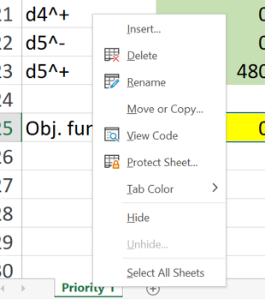
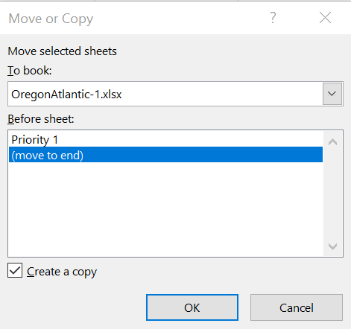

Goal Programming in Excel
Instructions for solving goal programming problem in Excel
Top priority objective has been optimized (see tab Priority 1)
Almost all groups have different initial solutions ( Group I and IV identical)
Copy sheet Priority 1 and rename Priority 2 (right click on tab)

Slide 13
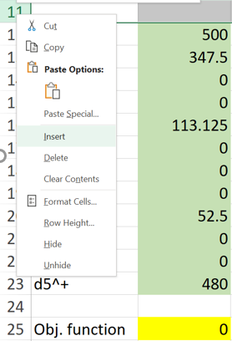
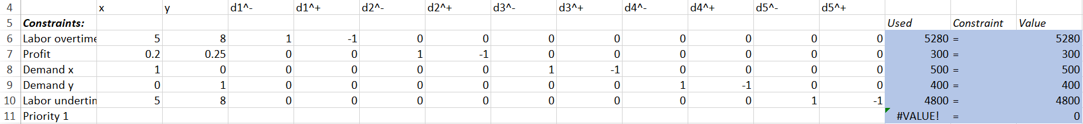
Goal Programming in Excel
Instructions for solving goal programming problem
Create new constraint in tab Priority 2 based on previous results for Priority 1
Set value equal to
previous minimization
Formula with MMULT

Slide 14
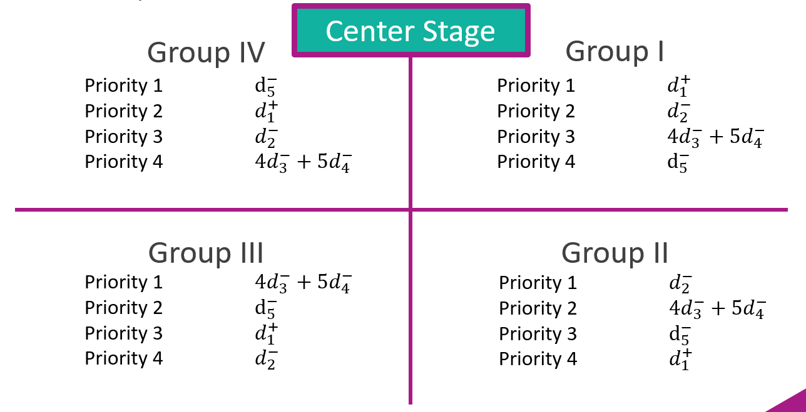
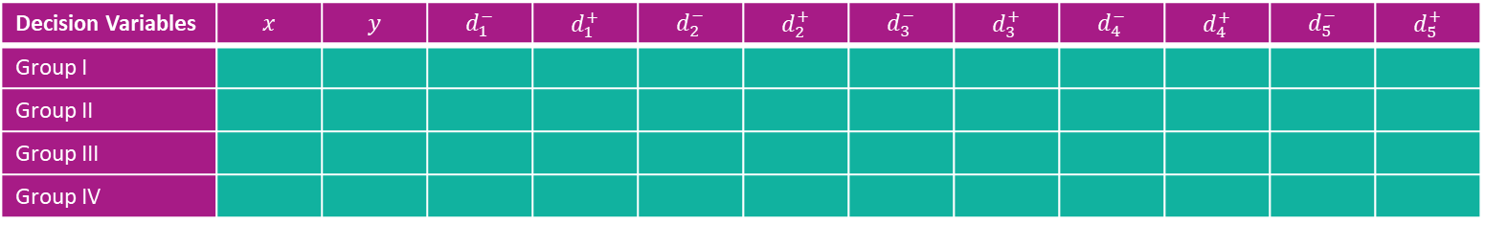
Ex: Oregon Atlantic Company
Recall your group’s objectives in order of priority
We want to fill in the following table
Decision Variables | $$x$$ | $$y$$ | $$d_{1}^{−}$$ | $$d_{1}^{+}$$ | $$d_{2}^{−}$$ | $$d_{2}^{+}$$ | $$d_{3}^{−}$$ | $$d_{3}^{+}$$ | $$d_{4}^{−}$$ | $$d_{4}^{+}$$ | $$d_{5}^{−}$$ | $$d_{5}^{+}$$
Group I
Group II
Group III
Group IV

Slide 15




The End
Dale

